Slide 1
Accenture Management Consulting Story
What’s your next challenge?

Slide 2

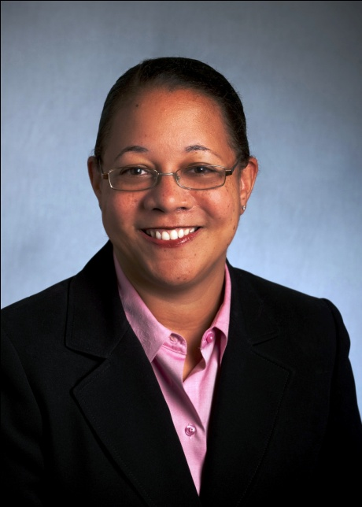
Welcome!
Ravi Chanmugam,
Partner Sponsor
Accenture Management Consulting Recruiting
Kristina (Tina) Gilbert,
Partner Sponsor
AMC Diversity Recruiting
(MBA Jump Start and MLT Sponsor)

Slide 3
Contents
About Accenture Management Consulting
Our Differentiation
Core Elements of a Career With Us
Questions & Answer

Slide 4
Join a leader in Management Consulting
Accenture brings the best people together to advance the science of management consulting.
16,000 management consultants in 49 countries
Delivering high performance for the most stimulating and challenging clients across public and private sectors, including 94 of the Fortune 100
A proven management consulting approach based on continuous research and practical application
An energizing and collaborative culture with exceptional, down to earth people from diverse backgrounds
A commitment to training with a broad curriculum including Strategy College
4

Slide 5
Accenture Management Consulting is core to the rest of Accenture
Accenture Management Consulting is core to the rest of Accenture
We help our clients move from issue to outcome with pace, certainty, and strategic agility.
Communications,
Media
& Entertainment
Financial Services
Health &
Public
Service
Products
Resources
Management Consulting
Technology
Business Process Outsourcing
5

Slide 6
We focus on growing industry and functional capabilities to deliver client value
Accenture management consultants build skills and knowledge around industry and functional dimensions to enable them to effectively address our clients’ issues:
The industry and functional groups where our management consultants work include:
Industry Strategy Groups:
Communications, Media & Entertainment
Financial Services
Health & Public Service
Products
Resources
Functional Groups:
Corporate Strategy/Operating Model/M&A
Analytics
Customer Relationship Management
Finance & Enterprise Performance
Operations
Risk Management
Sustainability
Talent & Organization
Building on any previous industry experience and core skills, you will be aligned to either an industry or functional group during the internship.
This will give you an unparalleled opportunity to target and deliver value to clients with a real emphasis on industry and/or functional depth.
6

Slide 7
Contents
About Accenture Management Consulting
Our Differentiation
Core Elements of a Career With Us
Questions & Answer

Slide 8
Our clients are facing a number of challenges and opportunities today
Demographics & Urbanization
Disruptions & Barriers
Transforming in an Evolving Market
Technology & Mobility
Mergers, Acquisitions & Alliances
Profit & Cash Optimization
Operational Excellence
Driving Growth
Talent
Globalization
& Power Shifts
Innovation
Energy &
Commodities
Capital
& Regulation
Environment
& Sustainability
8

Slide 9

As a result, our clients have new and higher expectations towards consulting
We bring differentiated capabilities and deep industry insights that help clients move from issue to outcome.
Outcomes / Value for Money
Agility
Certainty
Pace
9

Slide 10
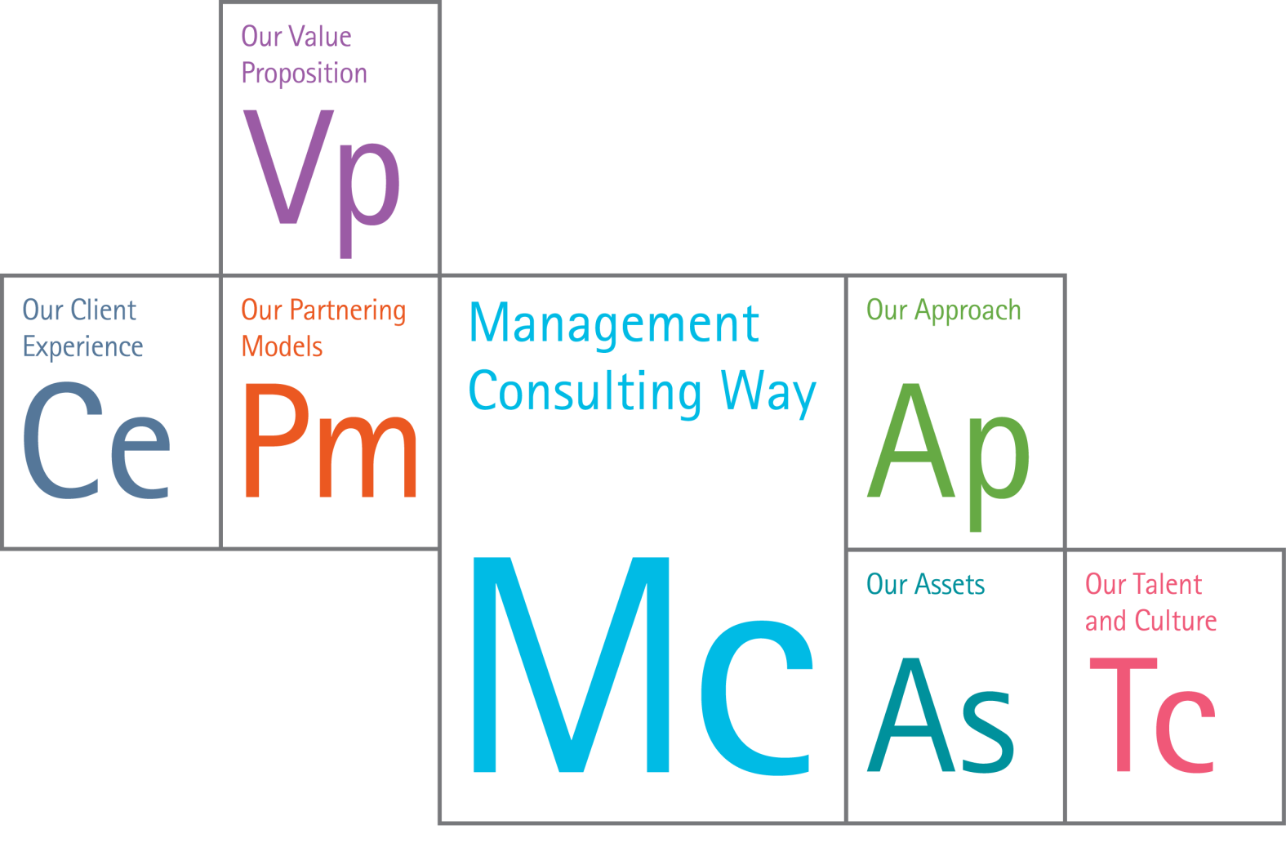
Our Differentiation: The six essential elements
10

Slide 11
The Summer Intern Experience
Juan Bolivar (Kelley)
Interned Summer 2011
Staffed to mining industry client analyzing distribution networks
“We were able to reach out to subject matter experts not staffed on the project and expect the same degree of guidance and support, as if they worked on the project team”
Justin Kilgore (Fuqua)
Interned Summer 2011
Staffed to a project to design and develop a model to track Corporate Finance synergies resulting from the merger of two global consultancies. (Not named Accenture!)
“Delivered value to our client by creating a way to quantify – in US$ – the amount of synergies they were able to realize as part of their new Finance solution”
Talbert Thomas (Goizueta)
Interned Summer 2010, rejoined July 2011
Recent client assignments include brand strategy and customer growth strategy for commercial bank developing business case to model the economic impact of customer growth initiatives; long range cost to serve strategic plan for international wireless company developing strategic initiatives to reduce the cost to serve over 5 year period
”Gratifying to reconnect with the network of people I bonded with during my internship experience. It has enriched my experiences in the development of thought capital, campus recruiting, and mentorship from senior leadership”

Slide 12
Contents
About Accenture Management Consulting
Our Differentiation
Core Elements of a Career With Us
Questions & Answer

Slide 13

Core elements of a career with us
Stimulating, challenging, cutting edge work
Valued contribution
Action, not just strategy
Collaborative and diverse culture
Enhanced learning
Deep skills across functional and industry dimensions
Multiple career paths
Put your experience to work!
13

Slide 14
Shape your own career
Given the size and scale of our business, there is ample opportunity to build on your MBA and gain the experience, training and specialized skills you need to progress rapidly along your chosen career path.
Accenture Strategy College custom training program
$600 million annual investment in training
Inspiring leaders, mentors and colleagues
Leadership development opportunities
Recognition that careers are highly individual so define your own career path, including fast path options
Accenture Alumni Network of 100,000+
14

Slide 15
Balance your personal life
We know it’s important for you to balance a successful career with a healthy lifestyle, and we offer a number of programs that will help you achieve this.
Supportive and enjoyable work environment
Networking groups and communities
Flexible work arrangements and time off packages
Future Leave and Hours That Help
Life Works and Limited Concierge Service
Fitness discounts, incentives and online support
At some point in your career, you may want to give back, and we have many options to help you do this in line with your passions and interests.
Skills to Succeed
Accenture Development Partnerships
Future Leave
Environmental Stewardship
Accenture US Eco Program
15

Slide 16
Work in an inclusive environment
At Accenture, we value diversity and different skill sets so you will have the opportunity to work with exceptional people in an inclusive and collaborative environment.
Diverse, cross cultural teams resulting in better solutions for clients
Mentoring and apprenticeships to accelerate learning and forge stronger bonds
Women’s initiatives to support career development and progression
Interest groups and networking programs demonstrate our commitment to inclusion and connect people with similar backgrounds and interests
16

Slide 17
A Diverse and Inclusive Culture: Interest Groups
The Hispanic American Interest Group | The African American Interest Group | The LGBT Network | The Asian American Networking | Women's Network
12 local affiliate locations Open forum to discuss personal, professional and career topics Professional direction and mentoring Internal education and employee morale National and local recruiting activities External relationships with diverse businesses Community service activities | 16 local affiliate locations Open forum to discuss personal, professional and career topics/ concerns Mentoring program to connect all AAIG people with trusted advisor Networking and professional development opportunities Community service activities | 20 local affiliate locations Fosters a sense of community Supports career development Builds internal awareness of LGBT issues Reflects our open and proactive acceptance of LGBT applicants Drives business by ensuring the inclusion of the LGBT community Developed domestic partners benefit for all employees | 17 local affiliate locations Open forum to discuss personal, professional and career topics Professional direction and mentoring Internal education and employee morale National and local recruiting activities External relationships with diverse businesses Community service activities | Women's Mentoring Programs Accenture Women’s Network More than 35 local Women’s Interest Groups Developing High-Performing Women training Commitment to attracting, retaining and advancing women International Women’s Day celebrations in 135 locations in 34 countries Annual women's research studies
17

Slide 18
The Case Interview
Demonstrate your ability to approach and solve a given business problem—like the ones you may face as a management consultant.
Interviewer presents a real business challenge or situation
Candidate explores the underlying causes of the problem and suggest recommendations
Evaluation based on the approach, not necessarily having the right answer
Cracking the Case
Structured Problem Solving Process
Listen to case
Clarify problem
Decompose problem
State hypotheses
Test hypotheses
Summarize findings
Success Factors
Balance creativity with practicality
Engage the interviewer throughout
Communicate articulately and persuasively
Demonstrate flexibility and poise
Manage time effectively
Practice, practice, practice!
18

Slide 19
Contents
About Accenture Management Consulting
Our Differentiation
Core Elements of a Career With Us
Questions & Answer

Slide 20
Thank-you for your time
Learn More:
http://accenture.com/managementconsultingcareers
http://accenture.com/careers
MBA 2012 Summer Internship Opportunities:
http://careers.accenture.com/us-en/landing-pages/Pages/mlt-jumpstart-mba.aspx
Consulting Careers and Internships tab
Deadline: December 23, 2011
Event ID: SuperDay (include on your application)
20

Slide 21
声明：
所有的版权属于原有公司，文件均来自公开渠道
此文件仅供学习使用，任何人不得进行以此为商业目的的行为
如有疑问，请立即删除
学习世界五百强和咨询公司PPT课程请访问如下网站搜索：“司马懿”
百度传课：司马懿PPT学校
网易学堂：司马懿PPT学校
知乎： 司马懿PPT学校
访问地址
https://www.chuanke.com
访问地址
https://study.163.com
访问地址
https://www.zhiu.com

